Slide 1
Hands-on session “users”
Introduction

Slide 2
Outline
The purpose of this session is to give a “hands-on” experience of using pysteps.
The session is divided into 5 exercise blocks + bonus exercises.
In the following slides, we give an introduction to the basic pysteps workflow.

Slide 3
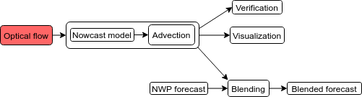
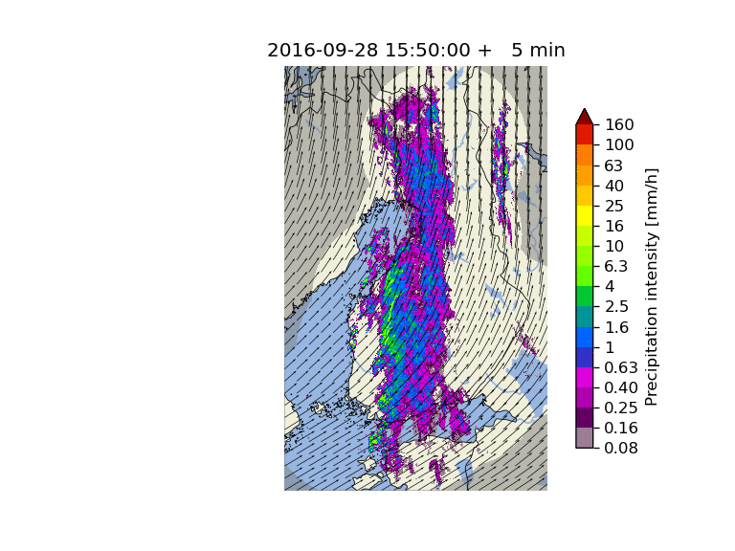
Optical Flow and Extrapolation
Advection (optical flow & extrapolation) is the key component of all pysteps nowcasting methods.
All methods are based on the “Lagrangian persistence” nowcast shown on the right.
Three different types of optical flow methods have been implemented in the motion module:
Feature tracking: Lucas-Kanade
Variational: VET and Proesmans
Spectral: DARTS
For advection, pysteps implements the backward semi-Lagrangian scheme in the extrapolation module.

Slide 4
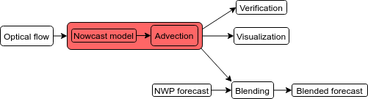
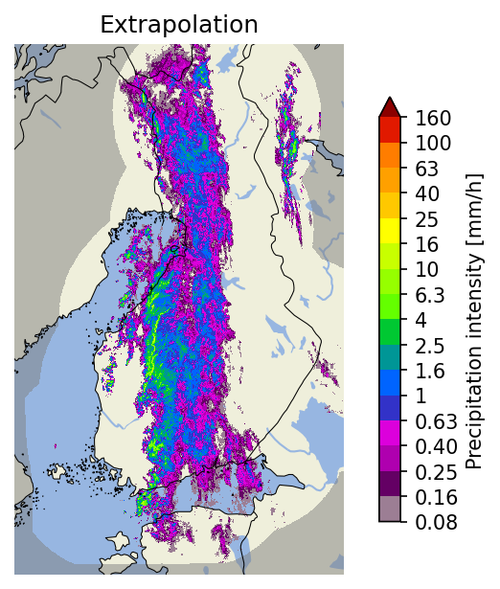
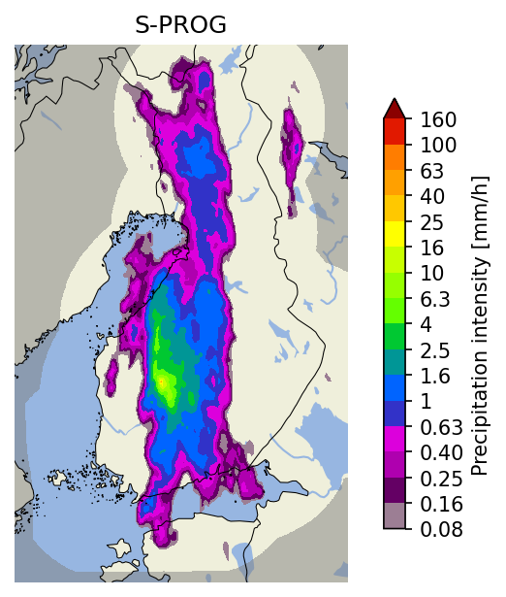
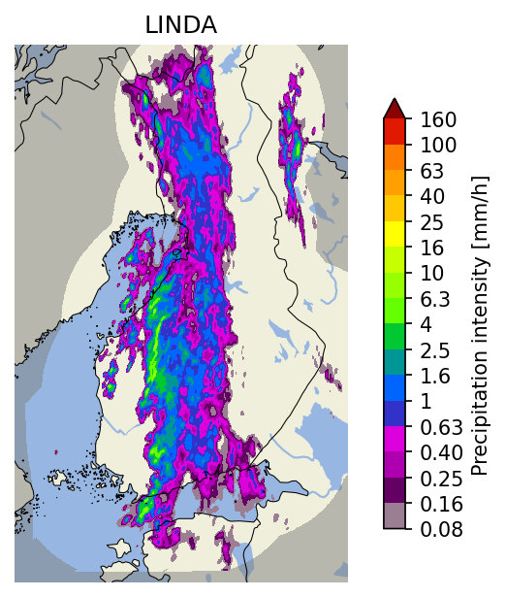
Deterministic Nowcasts
The main methods implemented in the nowcasts module:
Method | Pros | Cons | Typical computation time
Extrapolation | very fast | no prediction of growth or decay of precipitation | < 10 seconds
S-PROG | for low-intensity precipitation (< 1-2 mm/h) has generally the best skill choose for stratiform events | inability to preserve the spatial structure of rainfall fields, and particularly convective cells | < 20 seconds
LINDA-D | the most accurate method for intense precipitation (> 1-2 mm/h) choose for convective events | slow to compute | might take several minutes

Slide 5
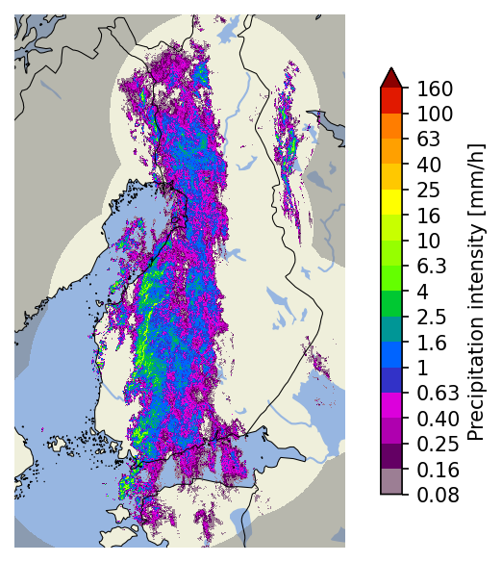
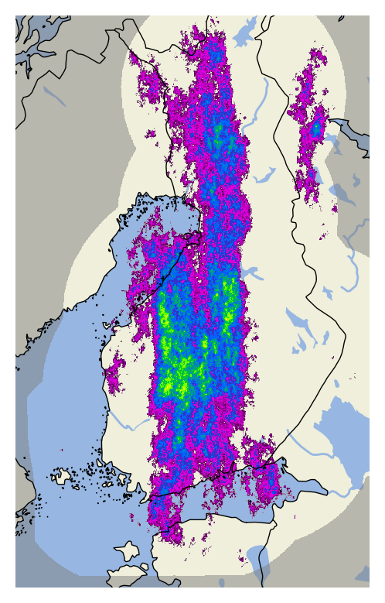
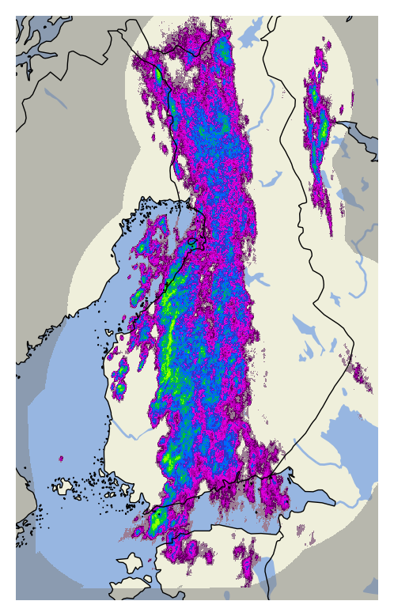
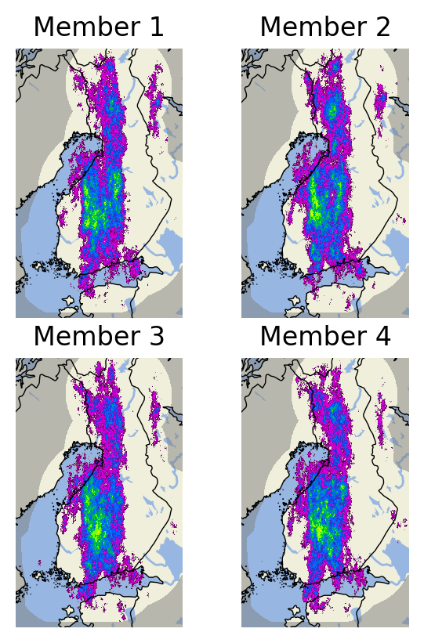
Ensemble Nowcasts
Observations at 2016-09-28 15:50 UTC
First ensemble members
STEPS
LINDA-P
The main ensemble methods implemented in the nowcasts module are STEPS and LINDA-P.
They model two sources of uncertainty: advection field estimation and Lagrangian growth and decay.
The basic rule for choosing the method:
stratiform events: STEPS
convective events: LINDA-P
LINDA-P generally produces more realistic ensemble members.
Computation times for the 4-member ensembles shown on the right:
STEPS: ~20 seconds
LINDA-P: ~5 minutes
Nowcast ensemble

Slide 6
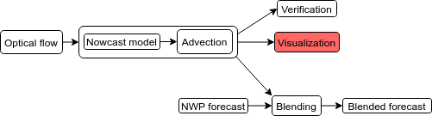
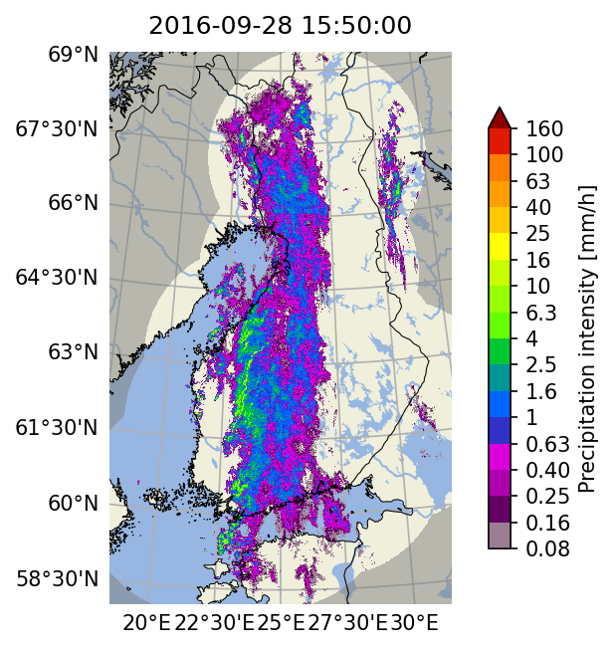
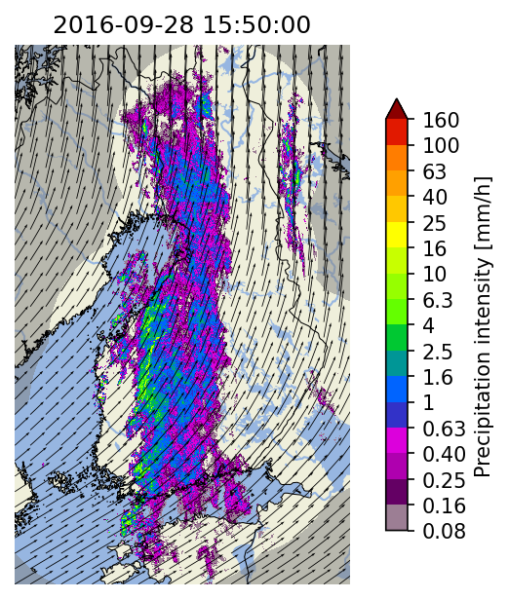
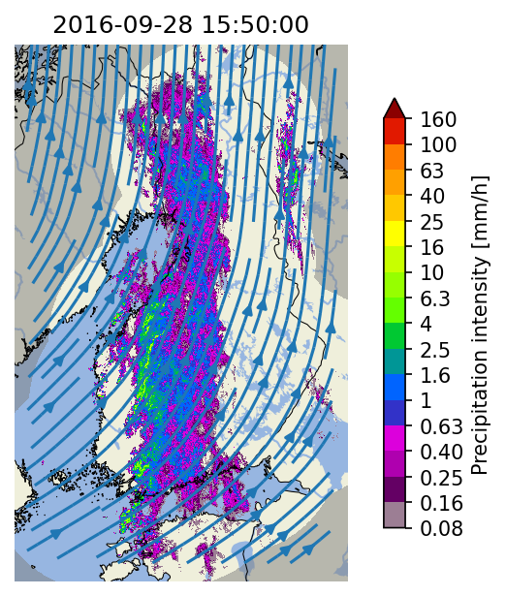
Visualization tools
Colorbars with several pre-configured scales and for different data units
Longitude-latitude lines with labels
Extensive set of visualization tools has been implemented in the visualization module
Support for multiple layers: basemap, precipitation and motion field
Plotting of basemaps by using cartopy
Quivers and streamlines for advection fields

Slide 7
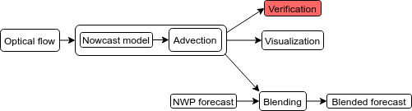
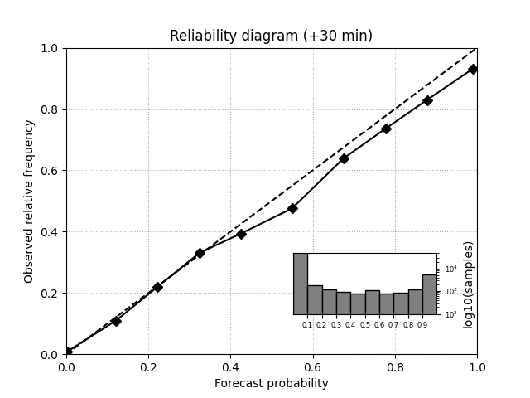
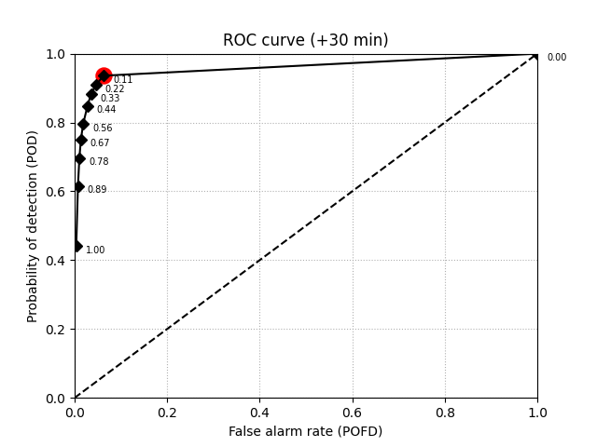
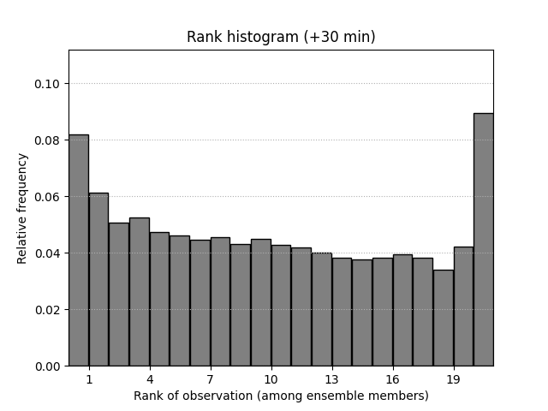
Verification tools / metrics
Examples of verification plots for
30-minute STEPS nowcasts
Metrics
A large number of verification utilities and metrics have been implemented in the verification module
Functionality
Creation of verification objects and aggregation from multiple nowcasts
Plotting of verification results
Deterministic
Categorical: CSI, ETS, POD, FAR
Continuous: MAE, ME
Scale/intensity-based metrics: FSS, intensity-scale
Radially averaged power spectral density (RAPSD)
Probabilistic
CRPS
Reliability diagram
Ensemble
Spread
Rank histogram

Slide 8
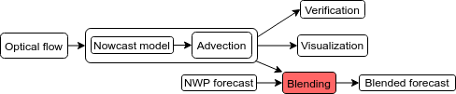
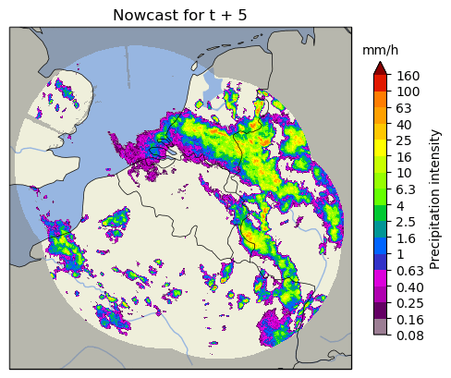
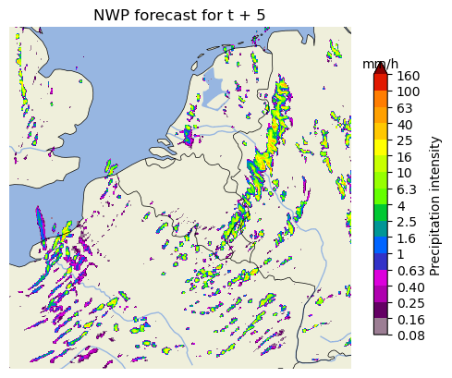
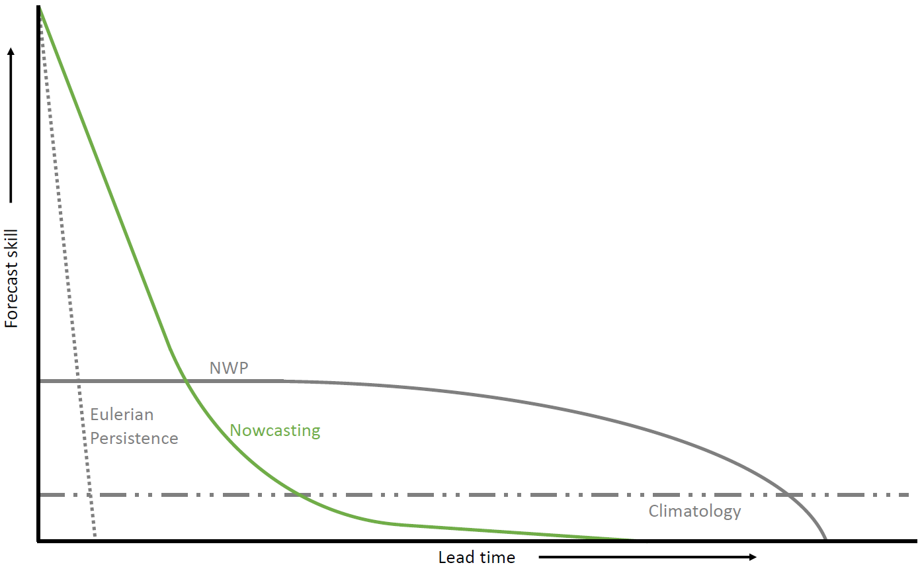
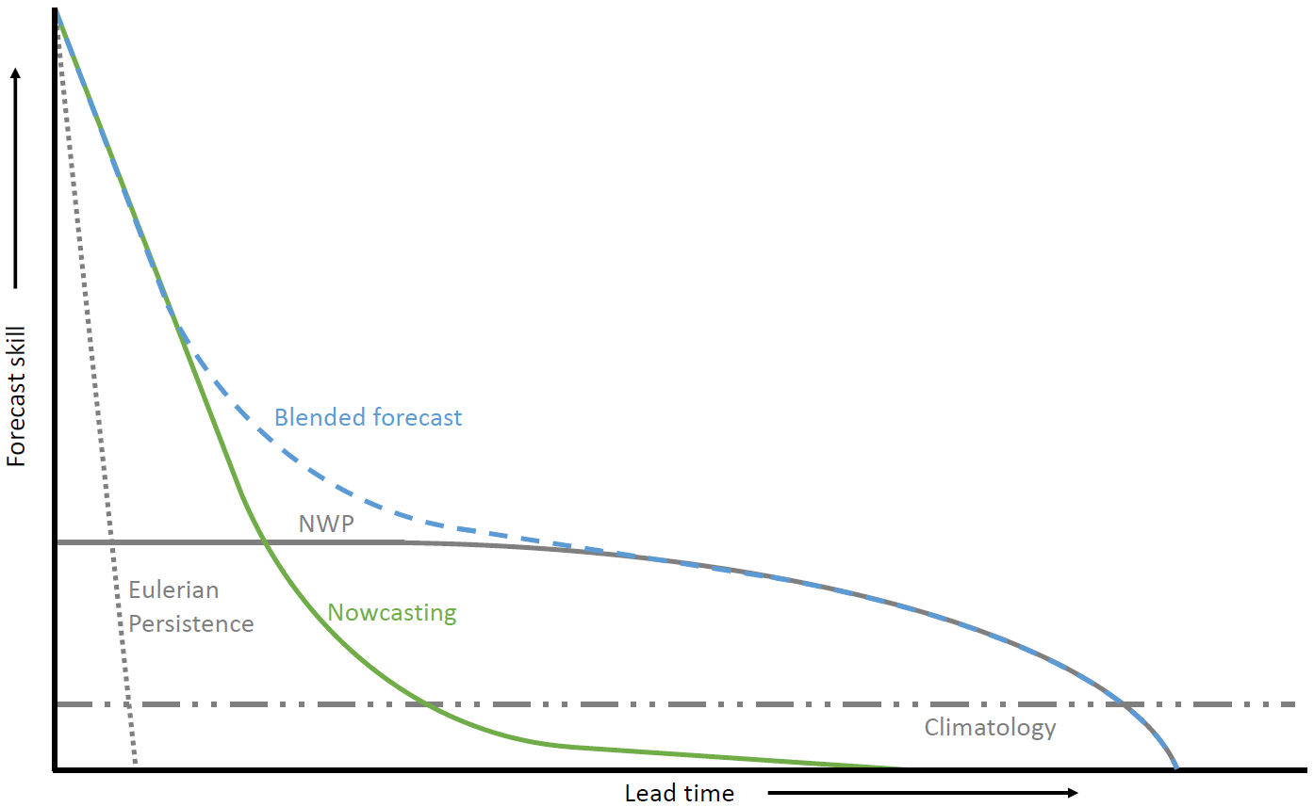
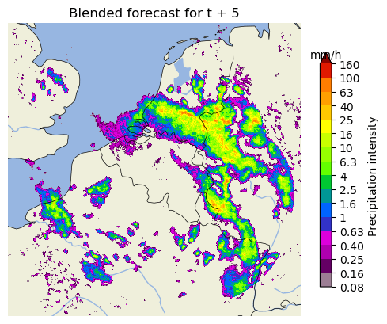
Blending with NWP
Nowcasting more skillful than NWP up to approx. 2 h. Often not enough for (flood) early warning.
How to improve the rainfall forecast up to 6 h or more ahead?

Slide 9
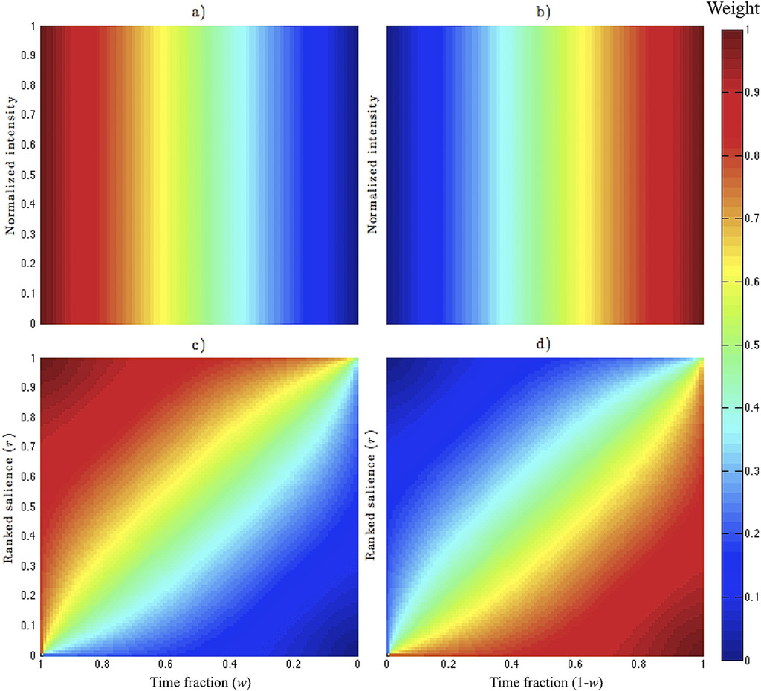
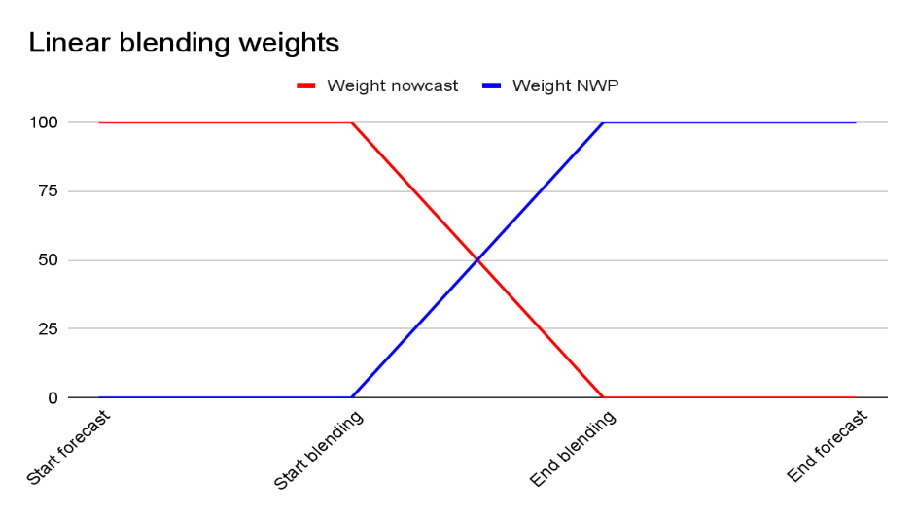
Blending with NWP: methods in pysteps
1. Linear blending
Fixed start and end point of blending procedure
Weights go linearly from 1 to 0 and 0 to 1.
2. Saliency-based blending
Similar to linear blending, but:
Preserves pixel intensities over time if they are strong enough according to their ranked salience.
3. STEPS blending (see next slide)
Hwang et al., 2015, Weather and Forecasting

Slide 10
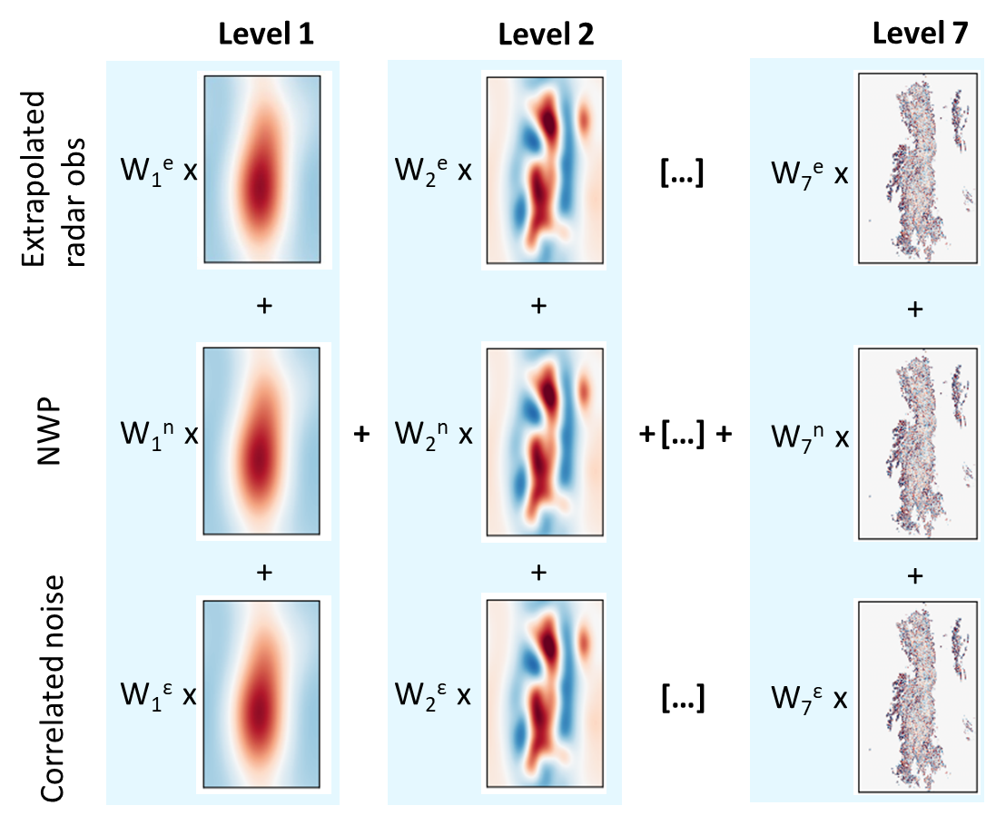
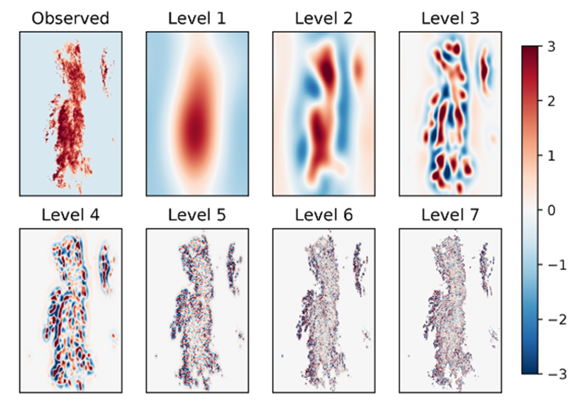
The STEPS method
See the QPN session on Monday (16:30 - 18:00) for more information about this method and its’ implementation in pysteps!
Per ensemble member:
Pulkkinen et al., 2019
Blending weights depend on initial and expected future skill

